Slide 1
Ray Tracing III
Review

Slide 2
Pseudo codes
RayCast-1
  Plain ray caster (direct illumination)
RayCast-2
  RayCast-1 + shadow rays
RayTrace-1
  Recursive ray tracer (+ reflection)
RayTrace-2
  Recursive ray tracer (+ refraction)

Slide 3
Pseudo codes
RayCast-1
  Plain ray caster (direct illumination)
RayCast-2
  RayCast-1 + shadow rays
RayTrace-1
  Recursive ray tracer (+ reflection)
RayTrace-2
  Recursive ray tracer (+ refraction)
Friday, Dec 2

Slide 4
Pseudo Code for RayCast-1
// Global Variables
rgb lsou; // intensity of light source
rgb back; // background intensity
rgb ambi; // ambient light intensity
Point light // position of light source
Object objects [n] // list of n objects in scene
Camera cam; // camera settings
Ray r;

Slide 5
My primitives in the scene
Plane
A,B,C,D // eq
1
Objects
Object
type
material
Sphere
O // center
R // radius
2
0
3
1
4
5
2
…
n
kd // diffuse reflectivity factor
ks // specular reflectivity factor
n // shininess factor
kr // refractivity index for each object

Slide 6
Image RayCast-1 (int width, int height)
{
  Image image = new Image(width, height);
  for (int i = 0; i < width; i++) {
    for (int j = 0; j < height; j++) {
      r = ConstructRayThroughPixel (i, j);
      Intersection hit = FindIntersection (r);
      image[i][j] = GetColor (r, hit);
    }
  }
  return image;
}

Slide 7
Image RayCast-1 (int width, int height)
{
  Image image = new Image(width, height);
  for (int i = 0; i < width; i++) {
    for (int j = 0; j < height; j++) {
      r = ConstructRayThroughPixel (i, j);
      Intersection hit = FindIntersection (r);
      image[i][j] = GetColor (r, hit);
    }
  }
  return image;
}

Slide 8
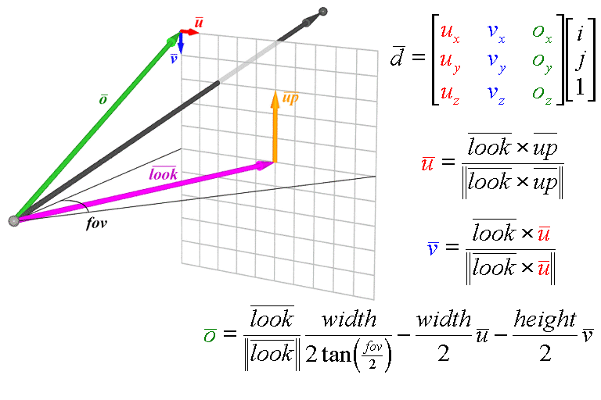
Perspective Ray Generation

Slide 9
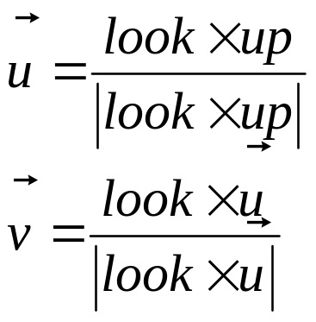
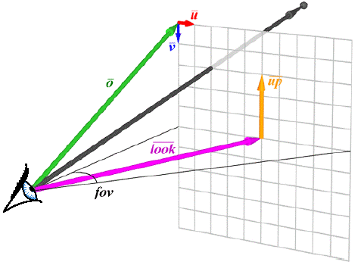
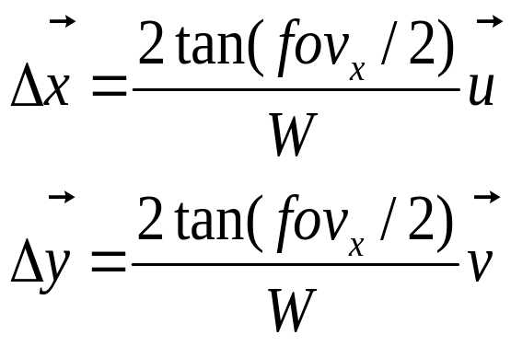
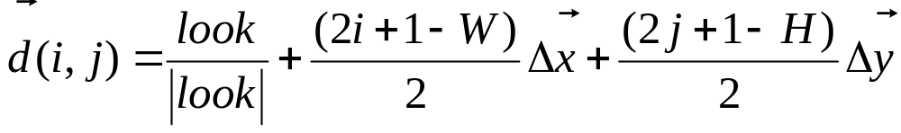
Perspective Ray Generation

Slide 10
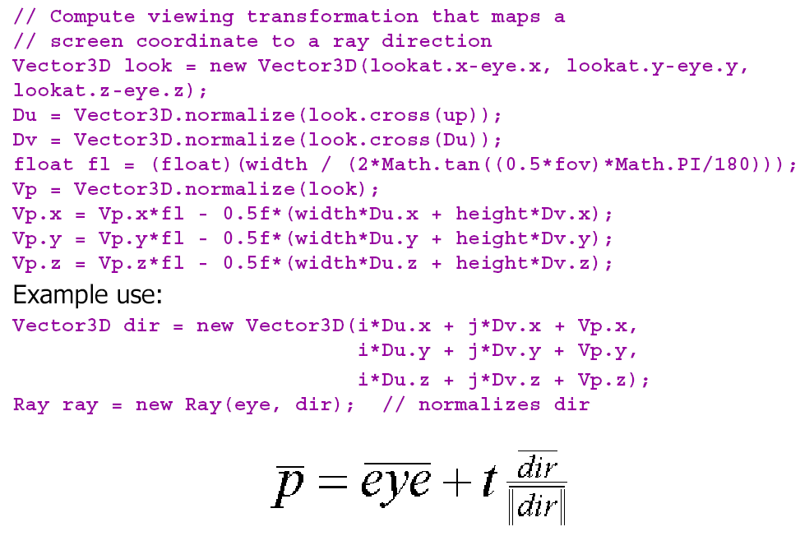
Perspective Ray Generation

Slide 11
Image RayCast-1 (int width, int height)
{
  Image image = new Image(width, height);
  for (int i = 0; i < width; i++) {
    for (int j = 0; j < height; j++) {
      r = ConstructRayThroughPixel (i, j);
      Intersection hit = FindIntersection (r);
      image[i][j] = GetColor (r, hit);
    }
  }
  return image;
}

Slide 12
My primitives in the scene
Plane
A,B,C,D // eq
1
Objects
Object
type
material
Sphere
O // center
R // radius
2
0
3
1
4
5
2
…
n
kd // diffuse reflectivity factor
ks // specular reflectivity factor
n // shininess factor
kr // refractivity index for each object
Intersection
index // closest-hit (-1 if none)
P // point
N // normal

Slide 13
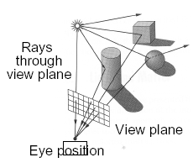
Ray-Scene Intersection
Intersections with geometric primitives:
Sphere
Plane
Triangle (you MUST implement the barycentric approach)
Groups of primitives (scene)
Slides sets!!
ray-lec-1
ray-intersect-2
Notes:
In order to implement this algorithm we had to address these six issues.

Slide 14
Image RayCast-1 (int width, int height)
{
  Image image = new Image(width, height);
  for (int i = 0; i < width; i++) {
    for (int j = 0; j < height; j++) {
      r = ConstructRayThroughPixel (i, j);
      Intersection hit = FindIntersection (r);
      image[i][j] = GetColor (r, hit);
    }
  }
  return image;
}

Slide 15
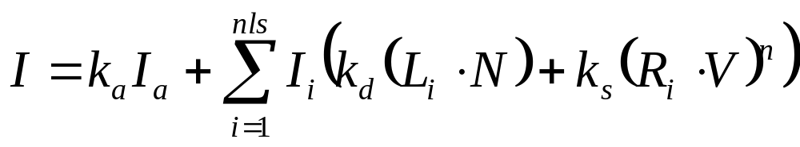
rgb GetColor (Ray r, Intersection hit)
{
rgb intensity;
if (hit.id = -1) // no intersection
intensity = back
else
Intensity = Phong_illumination (r, hit);
return intensity;
}

Slide 16
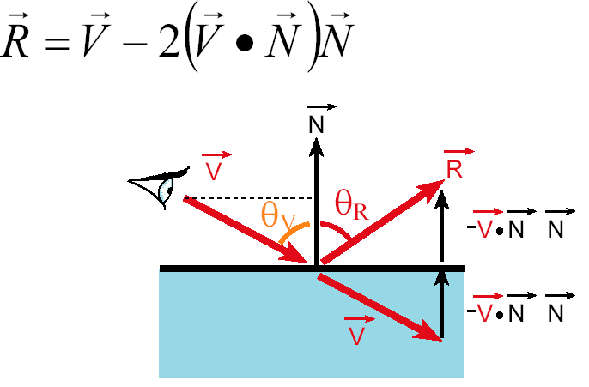
rgb Phong_Illumination (Ray r, Intersection hit)
{
rgb intensity;
return intensity;
}
N
L
r
R
P

Slide 17
Pseudo codes
RayCast-1
  Plain ray caster (direct illumination)
RayCast-2
  RayCast-1 + shadow rays
RayTrace-1
  Recursive ray tracer (+ reflection)
RayTrace-2
  Recursive ray tracer (+ refraction)
Mon, Dec 5

Slide 18
Pseudo Code for RayCast-2
// Global Variables – Exactly as in RayCast-1
rgb lsou; // intensity of light source
rgb back; // background intensity
rgb ambi; // ambient light intensity
Point light // position of light source
Object objects [n] // list of n objects in scene
Camera cam; // camera settings
Ray r;

Slide 19
// Exactly as in RayCast-1
Image RayCast-2 (int width, int height)
{
  Image image = new Image(width, height);
  for (int i = 0; i < width; i++) {
    for (int j = 0; j < height; j++) {
      r = ConstructRayThroughPixel (i, j);
      Intersection hit = FindIntersection (r);
      image[i][j] = GetColor (r, hit);
    }
  }
  return image;
}

Slide 20
rgb GetColor (Ray r, Intersection hit)
{
rgb intensity;
if (hit.id = -1) // no intersection
intensity = back
else {
shadow = CheckShadow (hit);
if (shadow) {
Kd = objects[hit.id].material.kd
Intensity = ambi * Kd
}
else Intensity = Phong_illumination (r, hit);
}
return intensity;
}

Slide 21
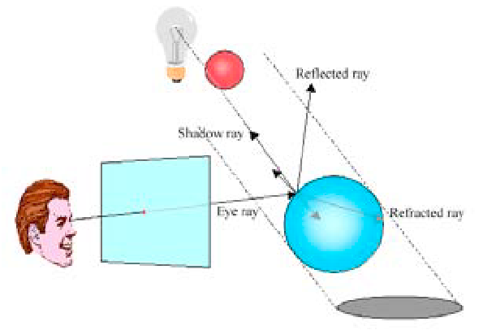
boolean CheckShadow (Intersection hit)
{
}

Slide 22


NOT in shadow!
Notes:
In order to implement this algorithm we had to address these six issues.

Slide 23
In shadow!
Notes:
In order to implement this algorithm we had to address these six issues.

Slide 24
Pseudo codes
RayCast-1
  Plain ray caster (direct illumination)
RayCast-2
  RayCast-1 + shadow rays
RayTrace-1
  Recursive ray tracer (+ reflection)
RayTrace-2
  Recursive ray tracer (+ refraction)
Wed, Dec 7

Slide 25
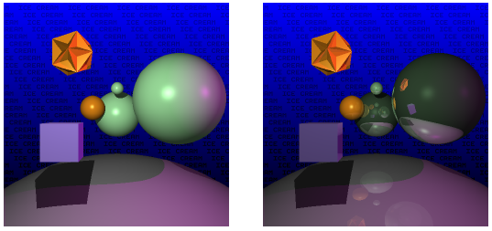
Reflection

Slide 26
Reflection
Reflection angle = view angle

Slide 27
Pseudo Code for RayTrace-1
// Global Variables
rgb lsou; // intensity of light source
rgb back; // background intensity
rgb ambi; // ambient light intensity
Point light // position of light source
Object objects [n] // list of n objects in scene
Camera cam; // camera settings
Int depth; // depth of ray tree consisting of multiple paths
Ray r;

Slide 28
Image RayTrace-1 (int width, int height)
{
  Image image = new Image(width, height);
  for (int i = 0; i < width; i++) {
    for (int j = 0; j < height; j++) {
      r = ConstructRayThroughPixel (i, j);
      image[i][j] = GetColor (r);
    }
  }
  return image;
}
Notice that now all ray-objects intersections are called within GetColor()

Slide 29
rgb GetColor (Ray r)
{
Ray flec; rgb spec, local, intensity;
depth = depth +1
if (depth >= 5) intensity = back;
else {
Intersection hit = FindIntersection (r);
if (hit.id = -1) intensity = back;
else {
if (objects.[hit.id].material.Ks >0) {
flec = ComputeReflectionRay (hit) ;
spec = objects.[hit.id].material.Ks* GetColor(flec);
} else spec = 0;
intensity = local + spec;
}
}
depth = depth -1
return intensity;
}
Recursive!
Check for shadow // as in RayCast-2()
shadow = CheckShadow (hit);
if (shadow) {
Kd = objects[hit.id].material.kd
local = ambi * Kd
}
else local = Phong_illumination (r, hit);

Slide 30
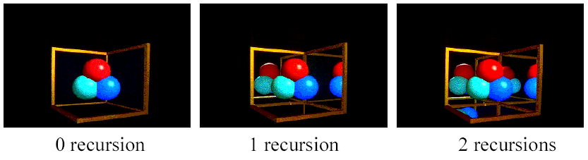
Reflection
The maximum depth of the tree affects the handling of refraction
If we send another reflected ray from here, when do we stop? 2 solutions (complementary)
  Answer 1: Stop at a fixed depth.
  Answer 2: Accumulate product of reflection coefficients and stop when this product is too small.

Slide 31
rgb GetColor (Ray r)
{
Ray flec; rgb spec, local, intensity;
depth = depth +1
if (depth >= 5) intensity = back;
else {
Intersection hit = FindIntersection (r);
if (hit.id = -1) intensity = back;
else {
if (objects.[hit.id].material.Ks >0) {
flec = ComputeReflectionRay (hit) ;
spec = objects.[hit.id].material.Ks * GetColor(flec);
} else spec = 0;
intensity = local + spec;
}
}
depth = depth -1
return intensity;
}
Recursive!
Check for shadow // as in RayCast-2()
shadow = CheckShadow (hit);
if (shadow) {
Kd = objects[hit.id].material.kd
local = ambi * Kd
}
else local = Phong_illumination (r, hit);

Slide 32
Memory
stack
spec = _____ *
local = ________ shadow? ___
intensity = _____ + _____
__
0
__
3
spec = _____ *
local = ________ shadow? ___
intensity = _____ + _____
eye
__
__
__
__
__
1
spec = _____ *
local = ________ shadow? ___
intensity = _____ + _____
2
0
(kd, ks, Phong) = (0.5, 0.7, 0.5)
spec = _____ *
local = ________ shadow? ___
intensity = _____ + _____
1
(kd, ks, Phong) = (0.1, 0.4, 0.3)
2
(kd, ks, Phong) = (0.6, 0.2, 0.7)
3
(kd, ks, Phong) = (0.3, 0.8, 0.8)
(back, ambi) = (0.32, 0.7)
depth = __________________

Slide 33
Pseudo codes
RayCast-1
  Plain ray caster (direct illumination)
RayCast-2
  RayCast-1 + shadow rays
RayTrace-1
  Recursive ray tracer (+ reflection)
RayTrace-2
  Recursive ray tracer (+ refraction)
Sat, Dec 10

Slide 34
Ray Tracing Issues (RayTrace-2)
I(P) = I_{local}(P) + k_{s}I(P_{r}) + k_{r}(P_{t})
Local term
Reflected
Transmitted
Cast a ray
Determine Intersections
For closest Intersection:
  Extend light shadow ray + calculate local term
  Spawn Reflected Ray (go to step 2)
  Spawn Transmitted Ray (go to step 2)

Slide 35
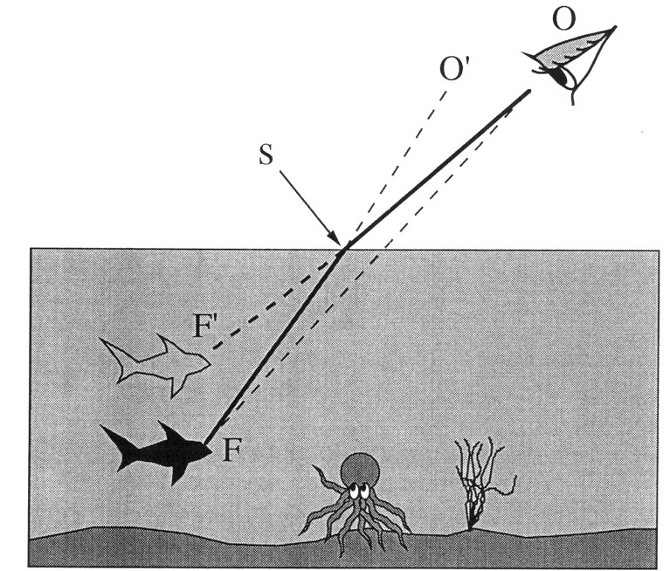
Refraction
From “Color and Light in Nature” by Lynch and Livingston

Slide 36


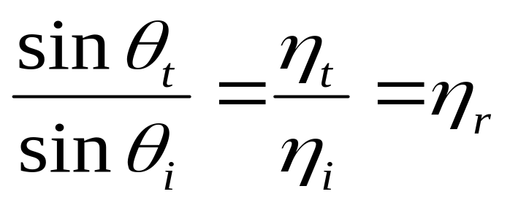





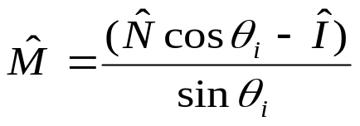



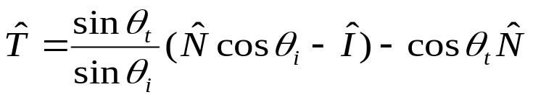

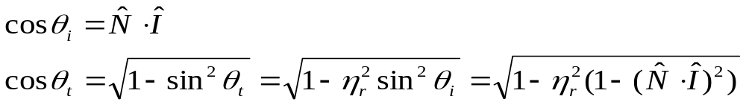
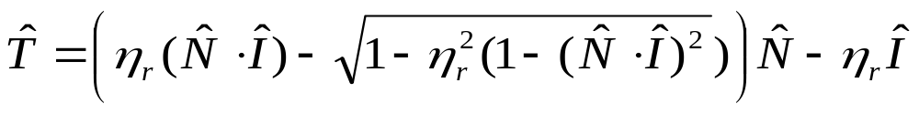
Refraction
Snell’s Law
Note that I is the negative of the incoming ray

Slide 37
Refraction
Snell’s Law
Index of Refraction
Note that I is the negative of the incoming ray

Slide 38
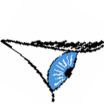
Refraction & Sidedness of Objects
Make sure you know whether you’re entering or leaving the transmissive material:
N
I
I
η_{i} = material
index
η_{i}=1
η_{T} = material
index
η_{T}= 1
T
T
N

Slide 39
Refraction Indices
Index of refraction for various materials:
Material Index
Vacuum 1.0
Air 1.0003
Water 1.33
Alcohol 1.36
Fused quartz 1.46
Crown glass 1.52
Flint glass 1.65
Sapphire 1.77
Heavy flint glass 1.89
Diamond 2.42

Slide 40
Ray
Notes:
In order to implement this algorithm we had to address these six issues.

Slide 41
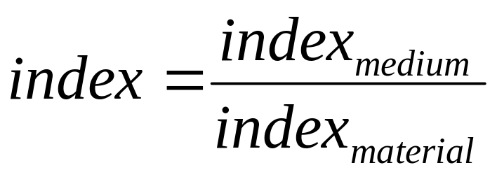
?
Notes:
In order to implement this algorithm we had to address these six issues.

Slide 42

Notes:
In order to implement this algorithm we had to address these six issues.

Slide 43
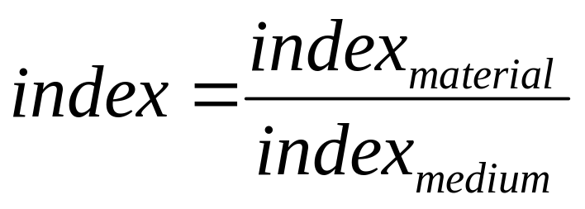
entry_position
Attention to the order!
?
Notes:
In order to implement this algorithm we had to address these six issues.

Slide 44
entry_position
Notes:
In order to implement this algorithm we had to address these six issues.

Slide 45
Pseudo Code for RayTrace-2
// Global Variables (same as in RayTrace-1)
rgb lsou; // intensity of light source
rgb back; // background intensity
rgb ambi; // ambient light intensity
Point light // position of light source
Object objects [n] // list of n objects in scene
Camera cam; // camera settings
Int depth; // depth of ray tree consisting of multiple paths
Ray r;

Slide 46
// Same as in RayTrace-1
Image RayTrace-2 (int width, int height)
{
  Image image = new Image(width, height);
  for (int i = 0; i < width; i++) {
    for (int j = 0; j < height; j++) {
      r = ConstructRayThroughPixel (i, j);
      image[i][j] = GetColor (r);
    }
  }
  return image;
}

Slide 47
rgb GetColor (Ray r)
{
Ray flec, frac; rgb spec, refr, local, intensity;
depth = depth +1
if (depth >= 5) intensity = back;
else {
Intersection hit = FindIntersection (r);
if (hit.id = -1) intensity = back;
else {
if (objects.[hit.id].material.Ks[j] >0) {
flec = ComputeReflectionRay (hit) ;
spec = Ks[j] * GetColor (flec);
} else spec = 0;
intensity = local + spec;
}
}
depth = depth -1
return intensity;
}
Recursive!
Check for reflection // as in RayTrace-1()
Check for shadow // as in RayCast-2()

Slide 48
rgb GetColor (Ray r)
{
Ray flec, frac; rgb spec, refr, local, intensity;
depth = depth +1
if (depth >= 5) intensity = back;
else {
Intersection hit = FindIntersection (r);
if (hit.id = -1) intensity = back;
else {
if (objects.[hit.id].material.Ks[j] >0) {
flec = ComputeReflectionRay (hit) ;
spec = Ks[j] * GetColor (flec);
} else spec = 0;
intensity = local + spec;
}
}
depth = depth -1
return intensity;
}
Recursive!
Check for reflection // as in RayTrace-1()
if (objects.[hit.id].material.Ks >0)
{
flec = ComputeReflectionRay (hit) ;
spec = objects.[hit.id].material.Ks * GetColor (flec);
} else spec = 0;
Check for shadow // as in RayCast-2()
shadow = CheckShadow (hit);
if (shadow) {
Kd = objects[hit.id].material.kd
local = ambi * Kd
}
else local = Phong_illumination (r, hit);

Slide 49
rgb GetColor (Ray r)
{
Ray flec, frac; rgb spec, refr, local, intensity;
depth = depth +1
if (depth >= 5) intensity = back;
else {
Intersection hit = FindIntersection (r);
if (hit.id = -1) intensity = back;
else {
if (objects.[hit.id].material.Kr >0) {
frac = ComputeRefractionRay (hit) ;
refr = objects.[hit.id].material.Kr * GetColor (frac);
} else refr = 0;
intensity = local + spec + refr;
}
}
depth = depth -1
return intensity;
}
Check for reflection // as in RayTrace-1()
Check for shadow // as in RayCast-2()

Slide 50
rgb GetColor (Ray r)
{
Ray flec, frac; rgb spec, refr, local, intensity;
depth = depth +1
if (depth >= 5) intensity = back;
else {
Intersection hit = FindIntersection (r);
if (hit.id = -1) intensity = back;
else {
if (objects.[hit.id].material.Kr[j] >0) {
frac = ComputeRefractionRay (hit) ;
refr = objects.[hit.id].material.Kr * GetColor (frac);
} else refr = 0;
intensity = local + spec + refr;
}
}
depth = depth -1
return intensity;
}
Recursive!
Check for reflection // as in RayTrace-1()
Check for shadow // as in RayCast-2()

Slide 51
rgb GetColor (Ray r)
{
Ray flec, frac; rgb spec, refr, local, intensity;
depth = depth +1
if (depth >= 5) intensity = back;
else {
Intersection hit = FindIntersection (r);
if (hit.id = -1) intensity = back;
else {
if (objects.[hit.id].material.Kr[j] >0) {
frac = ComputeReflectionRay (hit) ;
refr = Ks[j] * GetColor (frac);
} else refr = 0;
intensity = local + spec + refr;
}
}
depth = depth -1
return intensity;
}
Reflection
Refraction
Shadowing

Slide 52
My primitives in the scene
Plane
A,B,C,D // eq
1
Objects
Object
type
material
Sphere
O // center
R // radius
2
0
3
1
4
Triangle
(p1,p2,p3)
5
2
…
Mesh
class MD2
Other
…
n
kd // diffuse reflectivity factor
ks // specular reflectivity factor
n // shininess factor
kr // refractivity index for each object
Intersection
index // closest-hit (-1 if none)
P // point
N // normal

